Slide 1

EBSA Card Sort Activity Description
This card sort activity has been developed by the Shropshire EP Service to support Children and Young People (CYP) who may be experiencing Emotional Based School Avoidance (EBSA). The idea is to print, cut and laminate these cards (set of 40) to use with a CYP to help identify their worries around school.
When working with a CYP, you should identify and select 20 of the 40 cards which apply to them based on your prior knowledge of the CYP. Before starting the task, you will need to label one of your A3 sheets as ‘True About Me’ and the other as ‘Not True About Me’. Then, you should read out each card in turn to the CYP at a slow pace and ask them to place each card under either label. Once this has been completed, you should take a photo of each sheet of paper. Next, label one sheet of A4 as ‘Top 5 Most Like Me’ and using the cards from ‘True About Me’, ask the CYP to choose the top 5 which are most like them and place them accordingly. The other sheet of A4 should be labelled as ‘Top 5 I Would Most Like to Change’ and then ask the CYP to choose 5 of their cards from the ‘Not True About Me’ to place under what they would most like to change. Once this has been completed, take a picture of both sheets.
The ‘Top 5 I Would Most Like to Change’ should be used to form the basis of your action plan. Parents, School and the CYP can then work together to co-produce a plan which will inform how those changes can begin to be made.

Slide 2

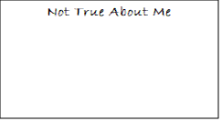
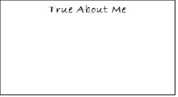
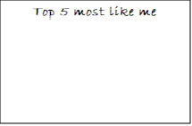
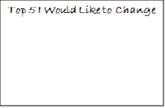
What you will need:
Set of 40 EBSA Cards
Four sheets of A3 Paper labelled:
Pen
Something to take a photo with

Slide 3
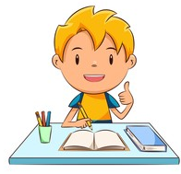

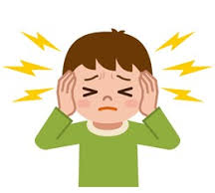
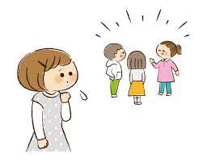




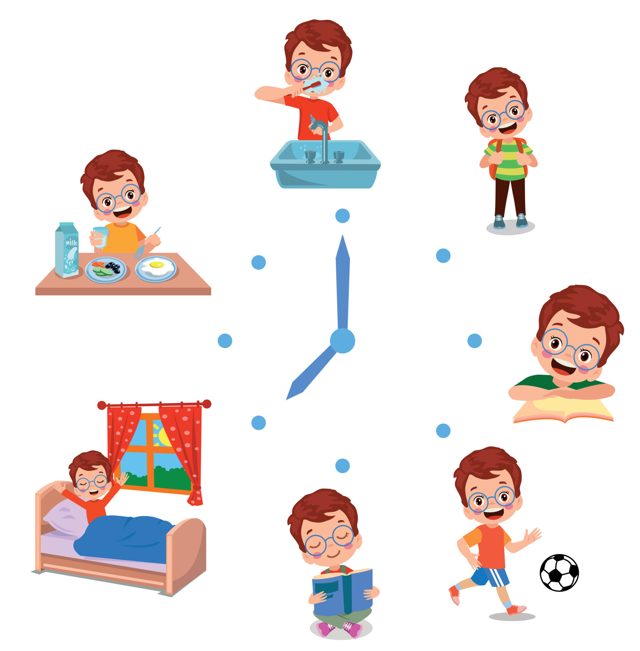
I feel worried at school
I wish I had friends
I don’t like it when it is noisy
I enjoy learning
I need lots of help with my learning
I feel happy coming to school
I don’t like surprise changes in the day
I feel worried at home

Slide 4
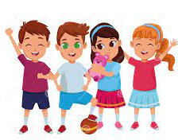
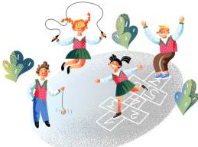


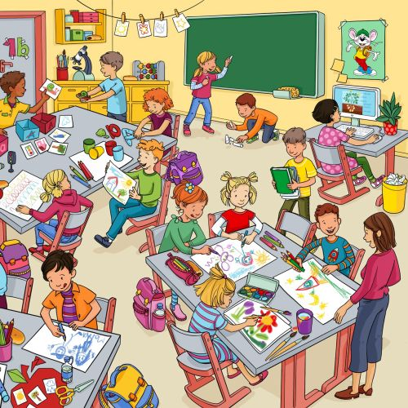


I would rather be at home than at school
I worry about breaktimes
I worry about getting to school
I have lots of friends
I don’t like it when the classroom is too busy
I worry about lunchtime
I worry about home time
I like my teachers

Slide 5
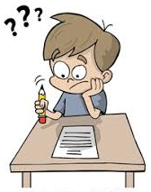

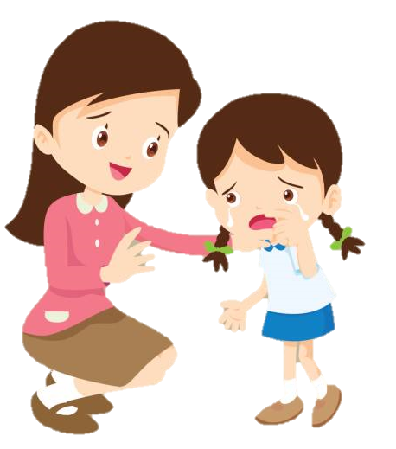
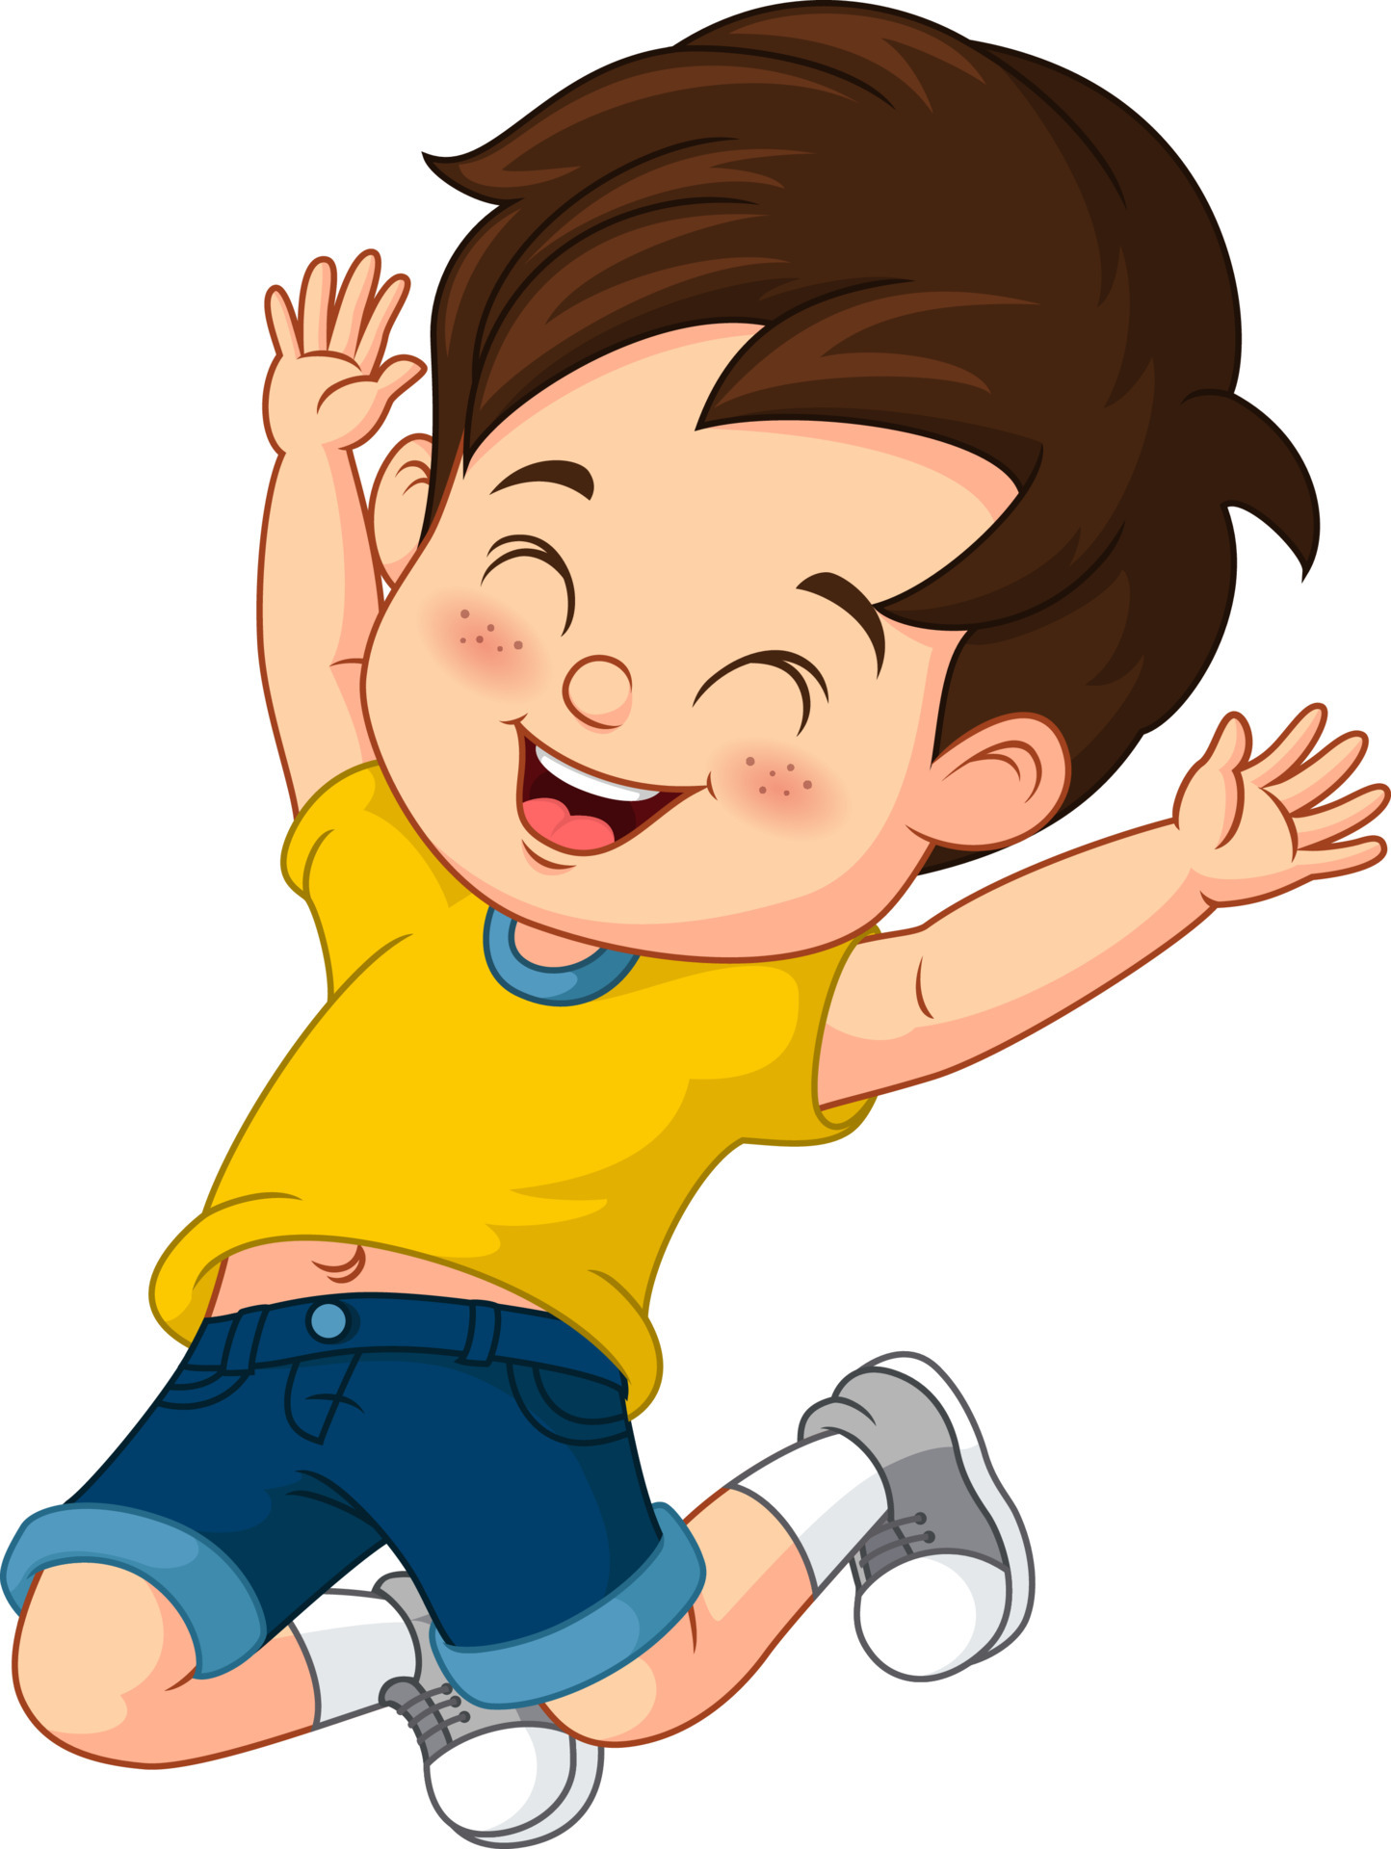

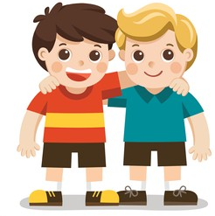
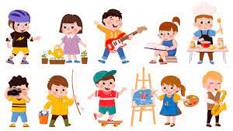
I worry about homework
I worry about school work
I don’t like my teacher
I can talk to my teacher
I can be myself at school
I feel safe in school
I have a special friend in school
I have lots of hobbies outside school

Slide 6
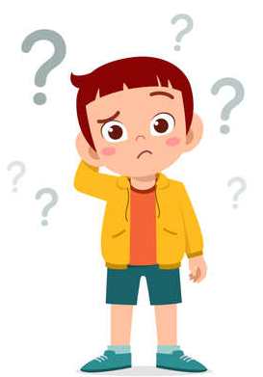

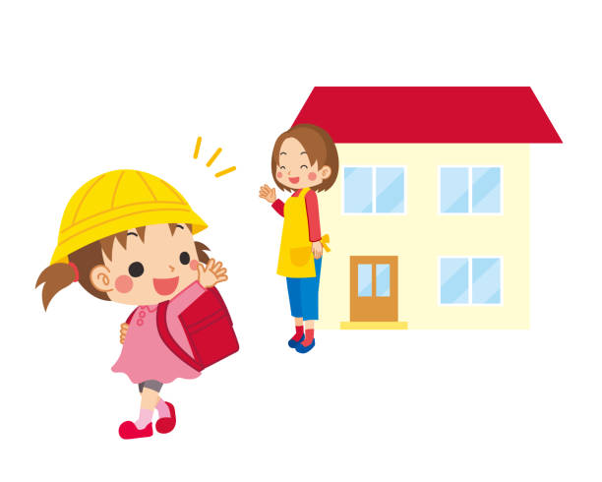
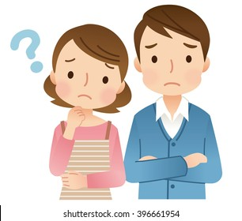
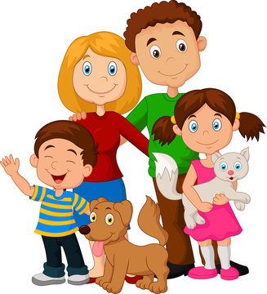
There is an adult I can talk to in school
I can talk about my feelings in school
I can talk about my feelings at home
The others are mean to me in school
I can’t talk about my feelings in school
I feel okay when I have to leave my parent/carers
There have been some changes in my family
My mum/dad need help

Slide 7
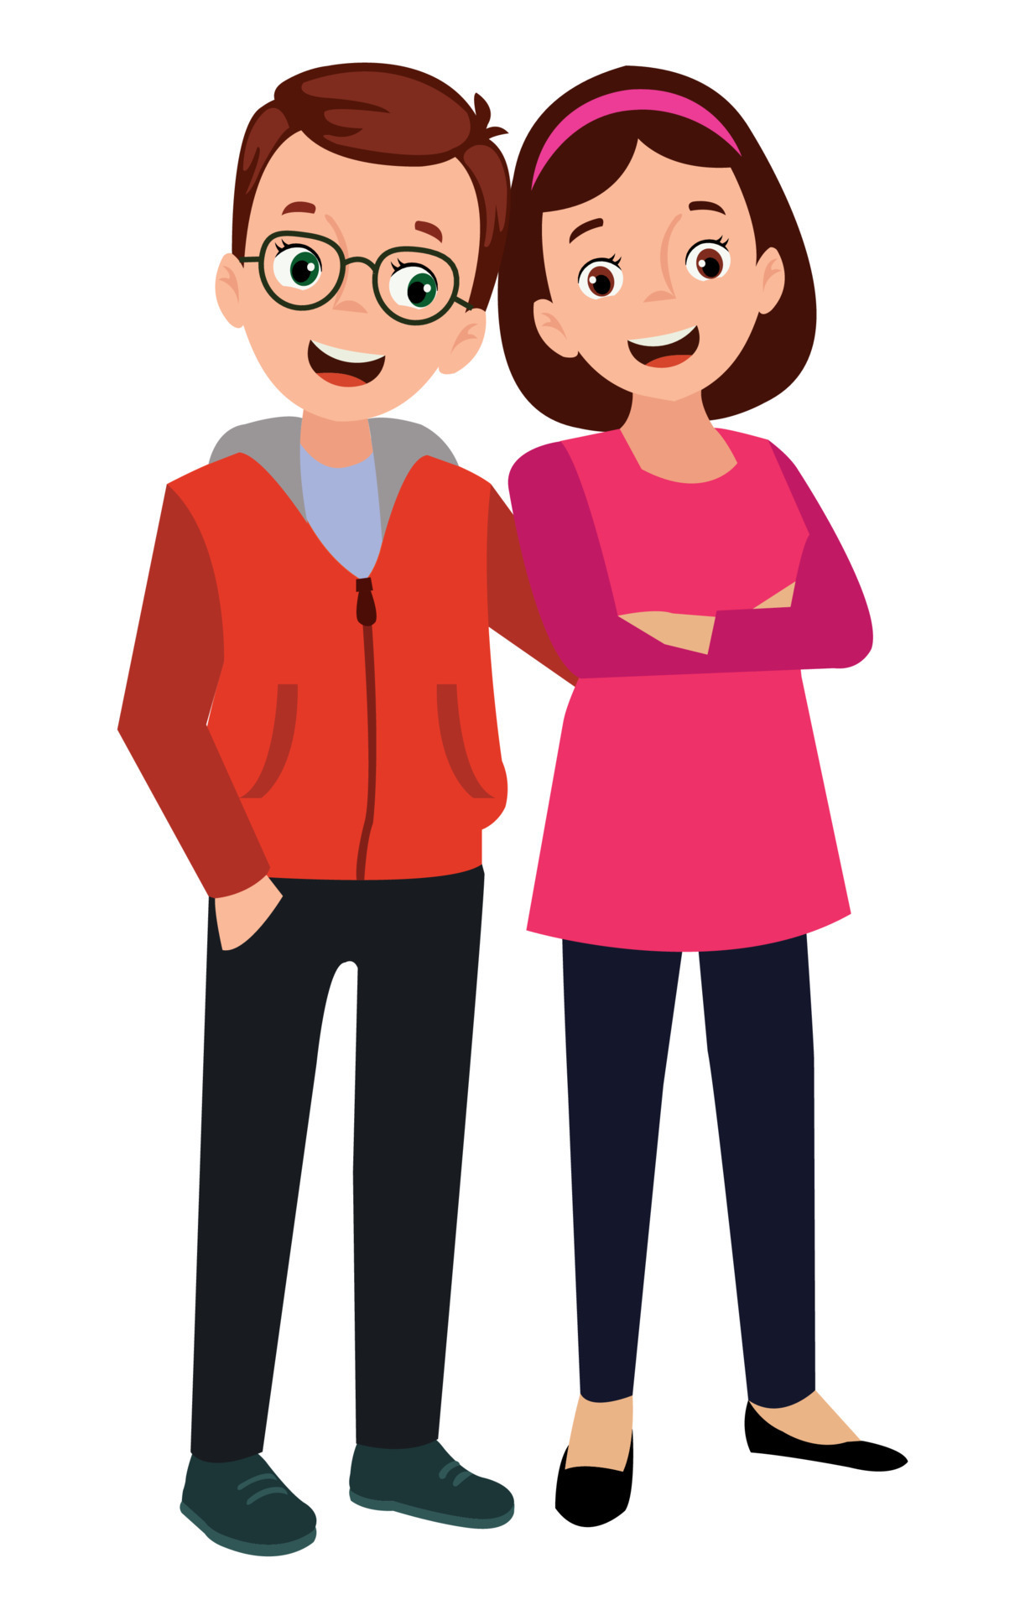


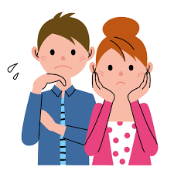
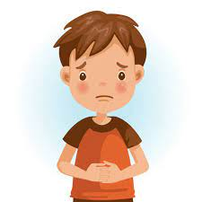


I know my family are okay when I am in school
I feel safe at home
I think a lot about Mum/Dad when I’m at school
I like being around other children
I miss my Mum/Dad when I’m at school
I worry about what’s happening at home when I’m at school
I feel Mum/Dad need me at home
I spend a lot of time with my family

Slide 8
I can’t talk about my feelings at home

