Slide 1

Letters and Sounds: Phase 1
Bite-size CPD training:
Beverley.jones@shropshire.gov.uk

Slide 2
Key points:
The importance of literacy: Literacy profoundly impacts children’s learning, future opportunities and social inclusion.
Synthetic phonics: Systematic synthetic phonics is the recommended, evidence – based approach for teaching reading.
Foundation skills: Before synthetic phonics, children need phonological awareness, print understanding and spoken language skills.
Letters and Sounds Phase 1: These activities focus on speaking, listening, phonological awareness and oral blending and segmenting, the foundation skills needed to follow a systematic synthetic phonics programme, when the children start Reception.

Slide 3
Introduction:
Being literate has a profound impact on children’s learning and their future opportunities.
According to the National Literacy Trust, children who start school without the necessary literacy, language and communication skills face significant disadvantages. They are less likely to succeed at school, struggle to enter the job market as young adults, and may find it challenging to support their own children’s learning as parents.
This lack of literacy skills can perpetuate social exclusion and hinder the creation of a fairer society for future generations.

Slide 4

Teaching reading:
Since the Rose Review of reading in 2006, there has been a strong shift towards a single approach to teaching reading using systematic synthetic phonics. Rose’s work drew on evidence from both research and practice, which claimed that children taught using synthetic phonics had made more significant gains in contrast to children taught to read in different ways. The reviews findings were accepted by the government and Letters and Sounds was published.
The Education Endowment Foundation considers synthetic phonics to be one of the most secure and best evidenced areas of pedagogy and recommends all schools use a systematic approach to teaching it.
What to expect in the EYFS – a parents’ guide

Slide 5
Synthetic phonics:
“Phonics is a body of knowledge that is necessary for pupils to learn to read and spell, at whatever age.
Because of the complex alphabetical code of English, young children learning to read are taught explicitly the correspondences between letters and sounds (graphemes and phonemes), as well as the skill of blending the individual sounds together to read. The term ‘synthetic’ phonics refers to the verb ‘synthesise’, meaning ‘to combine’. The skill of segmenting words into their individual sounds is needed for spelling.
Word reading and spelling are ‘reversible processes. Reading involves blending sounds to say a whole word; spelling involves segmenting a whole word to identify the sound in it.”
Reading Framework (publishing.service.gov.uk)
(2023: p.43)

Slide 6
Choosing a synthetic phonics programme in schools:
“There is no statutory requirement for schools to choose one of the synthetic phonics programmes [SSP] on the validated list Choosing a phonics teaching programme - GOV.UK
Ofsted does not have a preferred programme or approach. What’s important is that schools take an approach that is rigorous, systematic and used with fidelity (any resources used should exactly match the Grapheme Phoneme Correspondence (GPC) progression of their chosen SSP approach), and that achieves strong results for all pupils, including the most disadvantaged. ”
Choosing a phonics teaching programme - GOV.UK

Slide 7
Before starting a synthetic phonics programme in Reception, young children need to develop several important foundational skills with their Early Years’ practitioners…

Slide 8
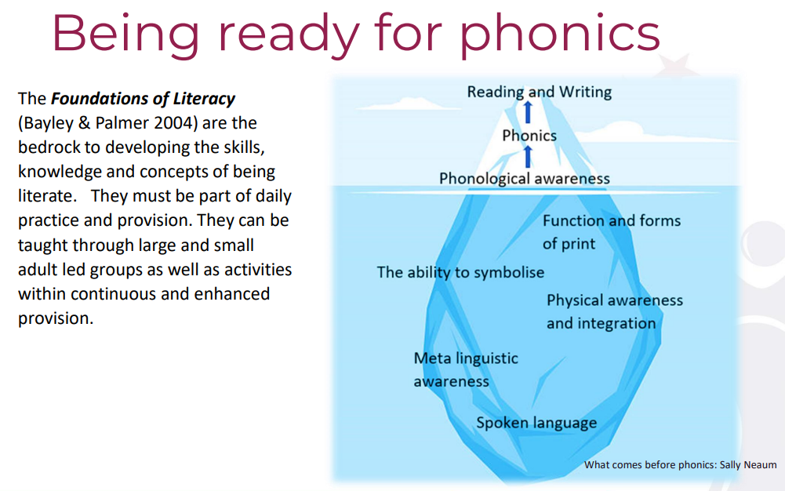
These foundational skills include:
“The tip of the iceberg peeps out from the water, supported beneath by a huge body
of ice. This is a good analogy for learning to read. The tip represents the visible skills of reading and writing, which are supported by a huge body of knowledge, understandings, skills and attitudes that under pin it. The robustness and strength of the top of the iceberg, is supported and underpinned by what lies beneath.”
Sally Neaum
What comes before phonics
(2021: p.29 -30)

Slide 9
These foundational skills include:
Phonological awareness –
The general ability to attend
to the sounds of language as
district from meaning.
An understanding of the functions
and forms of print.
Symbolise: to represent or express
something through use of symbols.
Physical activity that supports
sensory awareness and integration.
The ability to think and talk
about language.
Spoken language: the basis of
becoming literate.

Slide 10
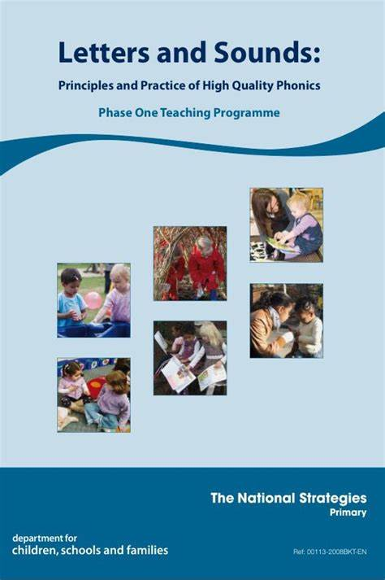
Letters & Sounds: Phase 1:
Phase One activities concentrate on developing children’s speaking and listening skills, phonological awareness and oral blending and segmenting, ready to begin a synthetic phonics programme when they start Reception.
Letters_and_Sounds_-_DFES-00281-2007.pdf

Slide 11
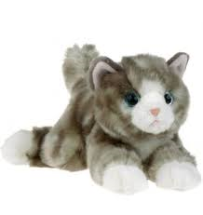
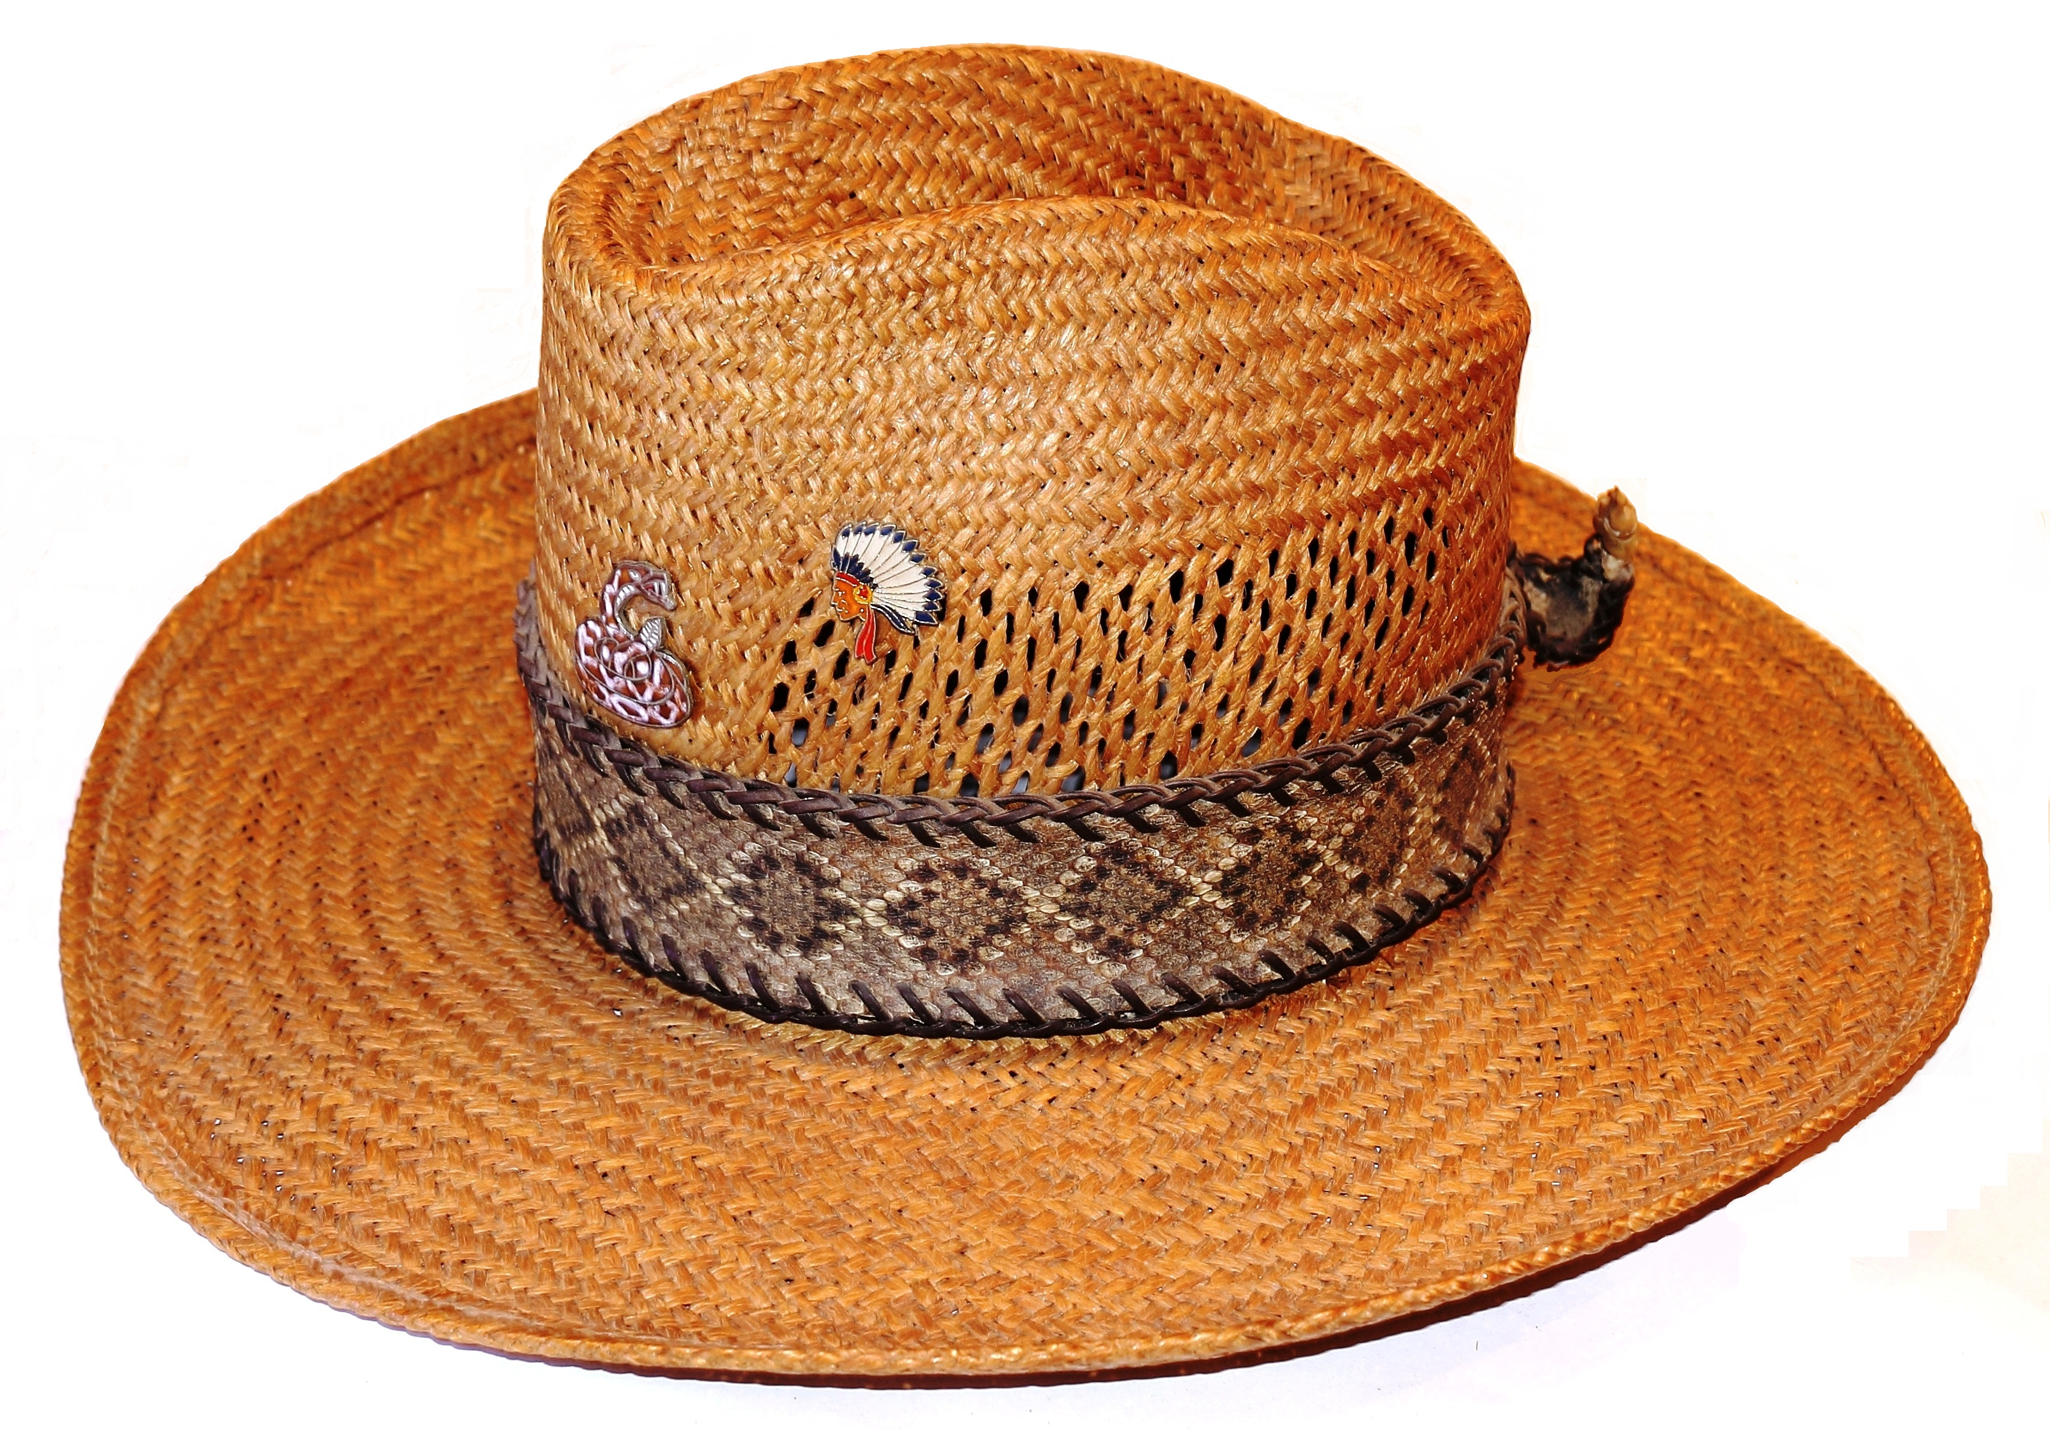
In the Summer Term before starting Reception, the children should be able to join in with the activities in Aspect 7:
Listen to sounds (phonemes) within words and to remember them in the order in which they occur.
Develop oral blending and segmenting of sounds (phonemes) in words.
To talk about the different phonemes that make up words.
You hold a toy cat and the children can say the sounds:
“c-a-t” followed by the word “cat”.
You hold up a hat and the children can say the sounds
“h-a-t” followed by the word “hat”.

Slide 12
Letters & Sounds: Phase 1:
Phase One activities are arranged under the following seven aspects.
■ Aspect 1: General sound discrimination – environmental sounds
■ Aspect 2: General sound discrimination – instrumental sounds
■ Aspect 3: General sound discrimination – body percussion
■ Aspect 4: Rhythm and rhyme
■ Aspect 5: Alliteration
■ Aspect 6: Voice sounds
■ Aspect 7: Oral blending and segmenting
Letters_and_Sounds_-_DFES-00281-2007.pdf

Slide 13
Letters & Sounds: Phase 1:
Each aspect is divided into three strands.
■ Tuning into sounds (auditory discrimination)
■ Listening and remembering sounds (auditory memory and sequencing)
■ Talking about sounds (developing vocabulary and language comprehension).
Each week aim to cover an activity from each of the three strands from Aspects 1-6, leaving Aspect 7 until the Summer Term before starting Reception.
Letters_and_Sounds_-_DFES-00281-2007.pdf

Slide 14
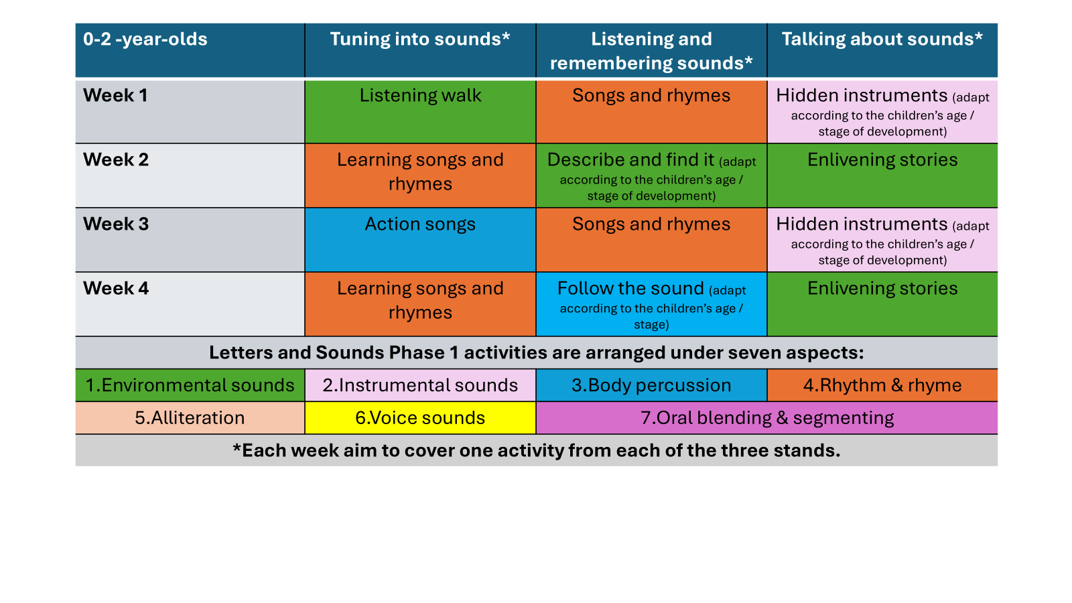
Weekly planning example:

Slide 15
Weekly planning example:
2 -3 -year-olds | Tuning into sounds* | Listening and remembering sounds* | Talking about sounds*
Week 1 | Listening walk | Songs and rhymes | Words about sounds
Week 2 | Action songs | Describe and find it | Musical show and tell (adapt according to the children’s age / stage of development)
Week 3 | Drum outdoors (adapt according to the children’s age / stage of development) | Songs and rhymes | Sound story time (adapt according to the children’s age / stage of development)
Week 4 | Rhyming books | Noisy neighbour 1 | Enlivening stories
Week 5 | Grandmother’s footsteps | Songs and rhymes | Watch my sounds (adapt according to the children’s age / stage of development)
Week 6 | Roly poly | Matching sounds (adapt according to the children’s age / stage of development) | Enlivening stories
Letters and Sounds Phase 1 activities are arranged under seven aspects:
1.Environmental sounds | 2.Instrumental sounds | 3.Body percussion | 4.Rhythm & rhyme
5.Alliteration | 6.Voice sounds | 7.Oral blending & segmenting
*Each week aim to cover one activity from each of the three stands.

Slide 16
Weekly planning example:
3 - 4 -year-olds | Tuning into sounds* | Listening and remembering sounds* | Talking about sounds*
Week 1 | A listening moment | Chain games | Silly soup
Week 2 | New words to old songs | Mrs Browning has a box | Give me a sound
Week 3 | Listen to the music | Matching sounds | Socks and shakers
Week 4 | Our favourite rhymes | Follow the sound | Story sounds
Week 5 | Sounds around (incl. tongue twisters) | Finish the rhyme | Noisy neighbour 2
Week 6 | Mouth movements | Musical corners | Odd one out
Letters and Sounds Phase 1 activities are arranged under seven aspects:
1.Environmental sounds | 2.Instrumental sounds | 3.Body percussion | 4.Rhythm & rhyme
5.Alliteration | 6.Voice sounds | 7.Oral blending & segmenting
*Each week aim to cover one activity from each of the three stands.

Slide 17
Weekly planning example:
3 - 4 -year-olds (cont.) | Tuning into sounds* | Listening and remembering sounds* | Talking about sounds*
Week 7 | Teddy is lost in the jungle | Target sounds | Mirror play
Week 8 | Adjust the volume | Describe and find it | Singing songs
Week 9 | Action songs | Matching sound makers | Enlivening stories
Week 10 | Rhyming soup | Noisy neighbour 1 | Animal sounds
Week 11 | Digging for treasure | Rhyming pairs | Words about sounds
Week 12 | Voice sounds | Our sound box / bag | I know a word
Include these activities the term before moving into Reception: | Toy talk / cross the river | Segmenting / say the words | Talk about different phonemes (sounds)
Letters and Sounds Phase 1 activities are arranged under seven aspects:
1.Environmental sounds | 2.Instrumental sounds | 3.Body percussion | 4.Rhythm & rhyme
5.Alliteration | 6.Voice sounds | 7.Oral blending & segmenting

Slide 18
Preparation for Letters and Sounds: Phase 1
Discuss and decide on the three activities you will deliver next week.
Collect all the resources together.
Store them in 3 boxes labelled strand 1, strand 2, strand 3.
Familiarise yourself with the activity from Letters and Sounds Phase 1.
After you have introduced the activity, let the children practise the activity and re-visit it during the week.
Make the activity multi-sensory and fun!
The video clips from Phase 1 Aspects 1-7 can now be found at:
https://www.youtube.com/playlist?list=PLbnabMMoy5rPK57WXrm3uDjDvJpgTdFRd
The clip illustrating the correct articulation of phonemes (sounds) can be found in the list at number 15 (between Phase 2 and Phase 3).

Slide 19
Additional resources and information:
BBC's Tiny happy people – activities for 0-5 for busy parents / carers Children's language development and parenting advice - BBC Tiny Happy People
Books and Rhymes 2 Year Olds - Sheringham Nursery School (sheringham-nur.org.uk)
Help for early years providers : Exploring words
https://www.sheringham-nur.org.uk/books-and-rhymes-3-4-year-olds/
Neaum, S. (2021) What comes before phonics? 2nd edition. London: Learning Matters.
The Literacy Trust https://literacytrust.org.uk
What is phonological awareness? Tips to help kids learn to read - BBC Tiny Happy People

